Slide 1
DJANGO VIEWS AND TEPLATES
江琳

Slide 2
views

Slide 3
Django MVT pattern
Model
Read/Write Database
HTTP Request
Url
Forward Request
View
HTTP Response
Template

Slide 4
Philosophy
A view function, or “view” for short, is simply a Python function that takes a web request and returns a web response.
This response can be the HTML contents of a Web page, or a redirect, or a 404 error, or an XML document, or an image, etc.

Slide 5
Views.py
In Django, views have to be created in the app views.py file.
books
migrations
__init__.py
__init__.py
admin.py
apps.py
models.py
tests.py
views.py

Slide 6

Simple view
Coding in books/views.py
from django.http import HttpResponse
def home(request):
return HttpResponse('Welcome to Libaray!')
In this view, we use HttpResponse to render the HTML .
To see this view as a page we just need to map it to a URL

Slide 7
url mapping
We access to view via a URL. Django has his own way for URL mapping and it's done by editing your project url.py file
library
__init__.py
settings.py
urls.py
wsgi.py

Slide 8

url
from django.conf.urls import include, url
from books.views import home
urlpatterns = [
url(r'^admin/', include(admin.site.urls)),
url(r'^$', home, name='home'),
]
When a user makes a request for a page on your web app, Django controller takes over to look for the corresponding view via the url.py file.
If not fount, a 404 not fount error is returned

Slide 9
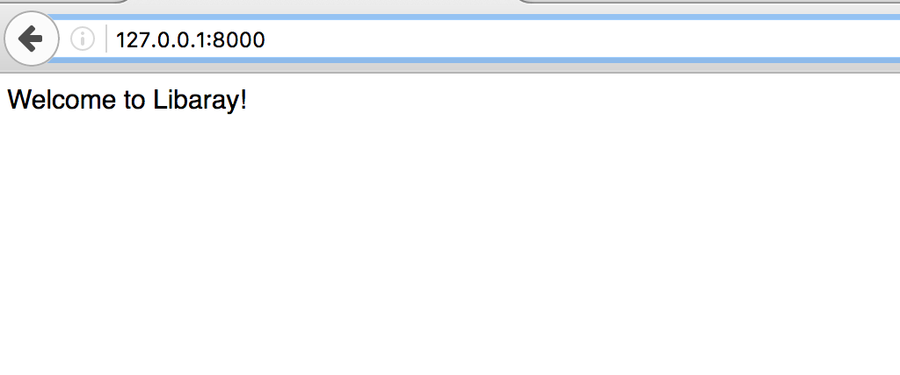
runserver
Runserver: python manage.py runserver
Open link: 127.0.0.1:8000

Slide 10

Simple view with parameters
Views can also accept parameters
# in books/view.py
def BookDetail(request, id): return HttpResponse(
'You are looking for book NO.%s' % id)

Slide 11
Simple view with parameters
# in library/urls.py
from django.conf.urls import include, url from django.contrib import admin from books.views import home, BookDetail urlpatterns = [ url(r'^admin/', include(admin.site.urls)), url(r'^$', home, name='home'), url(r'^book/(?P<id>\d+)/', BookDetail, name='book_detail'), ]

Slide 12
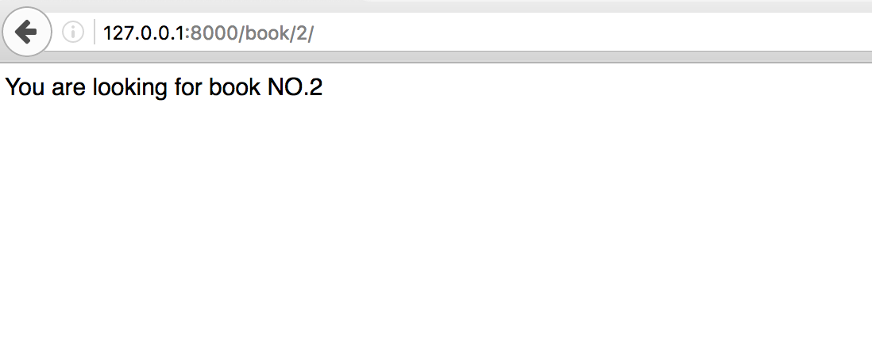
Simple view with parameters
Open link: 127.0.0.1:8000/book/2

Slide 13
Simple view with style
Let’s add some style
Modify home view in books/views.py
from django.http import HttpResponse def home(request): return HttpResponse('
<h1>Welcome to Libaray!</h1>')

Slide 14
There is a problem
You can not write all the HTML code in return
Now we need Django’s template system to separate the page design from Python.

Slide 15
templates

Slide 16
Philosophy
Django makes it possible to separate python and HTML, the python goes in views and HTML goes in templates. To link the two, Django relies on the render function and the Django Template language.

Slide 17
Philosophy
TEMPLATES setting in describes how Django will load and render templates.
The default settings file configures a DjangoTemplates backend whose APP_DIRS option is set to True. By convention DjangoTemplates looks for a “templates” subdirectory in each of the INSTALLED_APPS.

Slide 18
Settints.py
TEMPLATES = [ { 'BACKEND': 'django.template.backends.django.DjangoTemplates', 'DIRS': [], 'APP_DIRS': True, 'OPTIONS': { 'context_processors': [ 'django.template.context_processors.debug', 'django.template.context_processors.request', 'django.contrib.auth.context_processors.auth', 'django.contrib.messages.context_processors.messages', ], }, }, ]

Slide 19
Template
BACKEND: The template backend to use. The built-in template backends are:
'django.template.backends.django.DjangoTemplates'
'django.template.backends.jinja2.Jinja2’
DIRS: Directories where the engine should look for template source files, in search order

Slide 20
Template
APP_DIRS: Whether the engine should look for template source files inside installed applications.
Default is False
OPTIONS: Extra parameters to pass to the template backend. Available parameters vary depending on the template backend.

Slide 21
Template
TEMPLATES = [ { 'BACKEND': 'django.template.backends.django.DjangoTemplates', 'DIRS': [os.path.join(BASE_DIR, 'templates')], 'APP_DIRS': True, 'OPTIONS': { 'context_processors': [ 'django.template.context_processors.debug', 'django.template.context_processors.request', 'django.contrib.auth.context_processors.auth', 'django.contrib.messages.context_processors.messages', ], }, }, ]
Engine will look for template source file from this directories

Slide 22
Template
Let’s create directory named templates in your library directory.
library
accounts
books
library
templates
manage.py

Slide 23

First template
Create a html file named detail.html inside templates folder

Slide 24
First template – view.py
Modify books/views.py
from django.template import loader
def BookDetail(request, id): book = Book.objects.get(id=id) template = loader.get_template('detail.html') context = { 'book': book } return HttpResponse(
template.render(context, request))

Slide 25
First template
<!DOCTYPE html> <html lang="en"> <head> <meta charset="UTF-8"> <title>{{ book.name }}</title> </head> <body> <h1>{{ book.name }}</h1> <span> <b>Author:</b> {{ book.author }} <b>Publish by:</b>{{ book.publisher.name }} <b>Release at</b>:{{ book.pub_year }} </span> <h2>Introduction</h2> <div>{{ book.intro }}</div> </body> </html>
detail.html

Slide 26
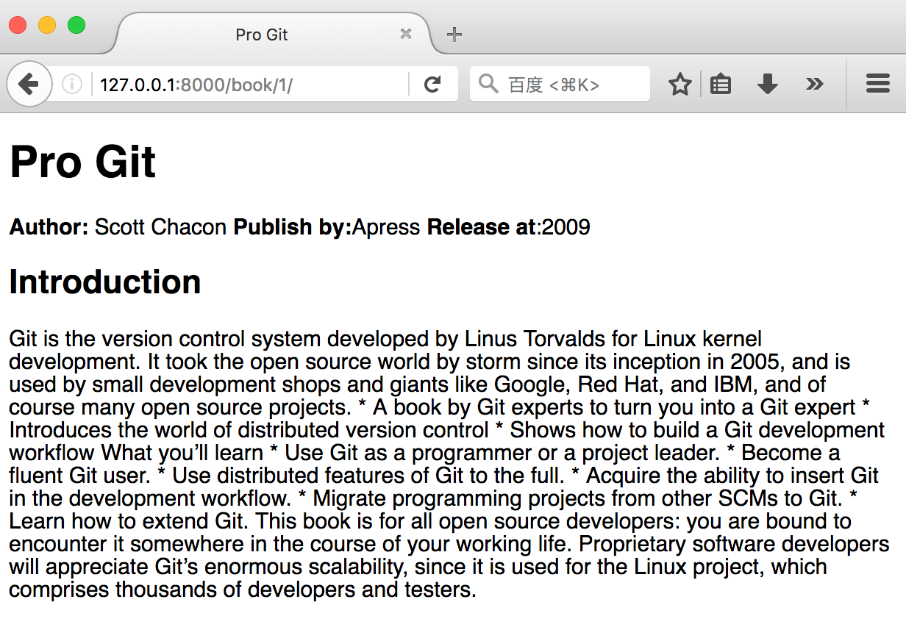
First template
Let’s open link 127.0.0.1:8000/book/1 to see the result.

Slide 27
Displaying Variables
A variable looks like this: {{variable}}. The template replaces the variable by the variable sent by the view in the third parameter of the render function.

Slide 28
A shortcut: render()
It’s a very common idiom to load a template, fill a context and return an HttpResponse object with the result of the rendered template.
Django provides a shortcut.
rewritten BookDetail() view :

Slide 29
A shortcut: render()
Books/views.py
from django.shortcuts import render
def BookDetail(request, id): book = Book.objects.get(id=id) context = {'book': book} return render(request, 'detail.html', context)

Slide 30
A shortcut: render()
The render() function takes the request object as its first argument, a template name as its second argument and a dictionary as its optional third argument.

Slide 31
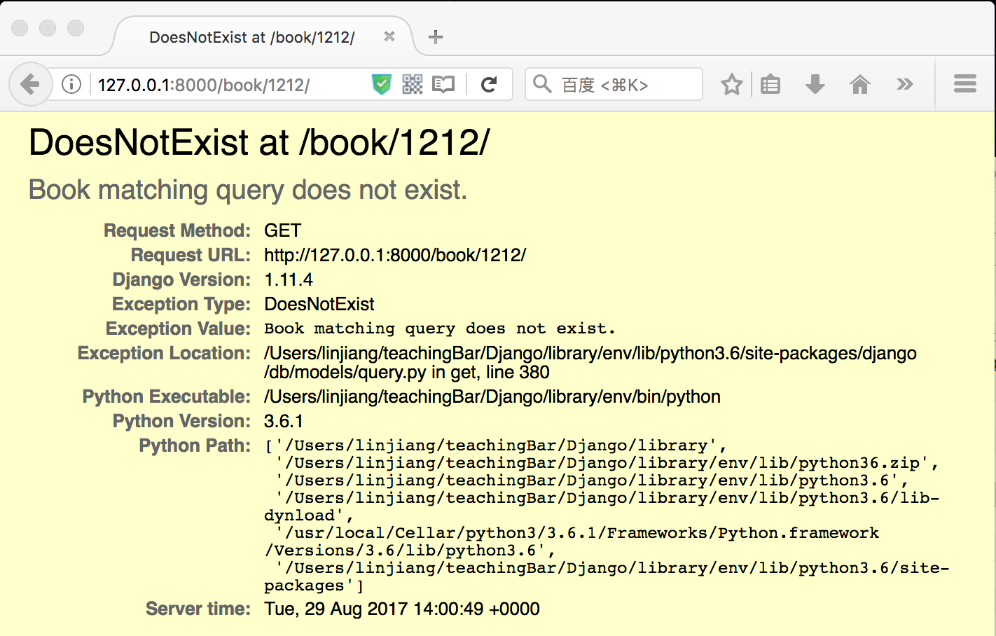
Raising a 404 error
Try: 127.0.0.1:8000/book/1212

Slide 32
Raising a 404 error
The view raises the Http404 exception if a question with the requested ID doesn’t exist.

Slide 33

Raising a 404 error
from django.shortcuts import render from django.http import Http404 from .models import Book
def BookDetail(request, id): try: book = Book.objects.get(id=id) except Book.DoesNotExist: raise Http404('Object does not exist!') context = {'book': book} return render(request, 'detail.html', context)
Now open the link 127.0.0.1:8000/book/1212 again

Slide 34
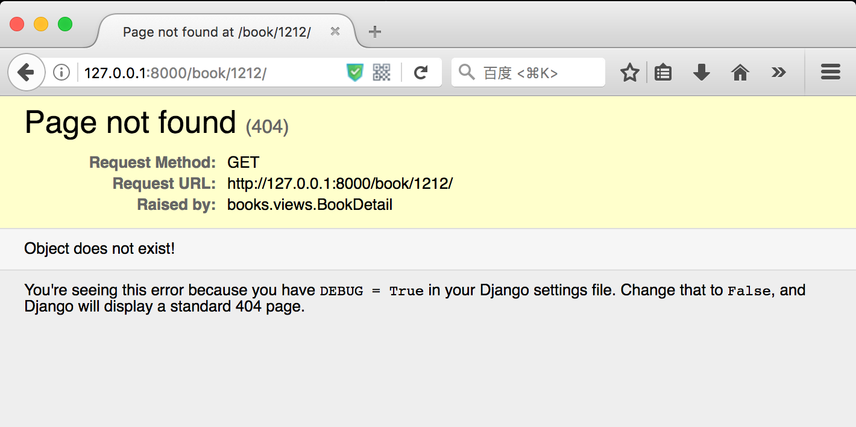
Raising a 404 error

Slide 35
A shortcut: get_object_or_404()
It’s a very common idiom to use get() and raise Http404 if the object doesn’t exist.
Django provides a shortcut get_object_or_404()

Slide 36
A shortcut: get_object_or_404()
from django.shortcuts import render, get_object_or_404
def BookDetail(request, id): book = get_object_or_404(Book, pk=id) context = {'book': book} return render(request, 'detail.html', context)

Slide 37
Library system
Assume the library system having the follow pages:
Homepage
A page list all books
A page show detail of a book
Using views, templates and queryset API to write below web page.

Slide 38
Questions?

